Slide 1
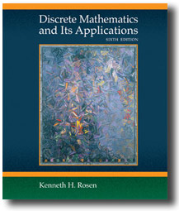

Chapter 2
Basic Structures: Sets, Functions, Sequences, and Sums
Discrete Mathematics
and Its Applications
Sixth Edition
By Kenneth Rosen
歐亞書局
Copyright © The McGraw-Hill Companies, Inc. Permission required for reproduction or display.

Slide 2
2.1 Sets
2.2 Set Operations
2.3 Functions
2.4 Sequences and Summations
歐亞書局
P. 111

Slide 3
2.1 Sets
Definition 1: A set is an unordered collection of objects
Definition 2: Objects in a set are called elements, or members of the set.
  a ∈ A, a ∉ A
  V = {a, e, i, o, u}
  O = {1, 3, 5, 7, 9}
  or O = {x|x is an odd positive integer less than 10}
  or O = {x∈Z⁺|x is odd and x<10}

Slide 4
  N={0, 1, 2, 3, …}, natural numbers
  Z={…,-2, -1, 0, 1, 2, …}, integers
  Z⁺={1, 2, 3, …}, positive integers
  Q={p/q|p∈Z, q∈Z, and q≠0}, rational numbers
  Q⁺={x∈R|x=p/q, for positive integers p and q}
  R, real numbers

Slide 5
Definition 3: Two sets are equal if and only if they have the same elements.
A=B iff ∀x(x ∈ A ↔ x ∈ B)
Venn diagram
  Universal set U
  Empty set (null set) ∅ (or {})

Slide 6
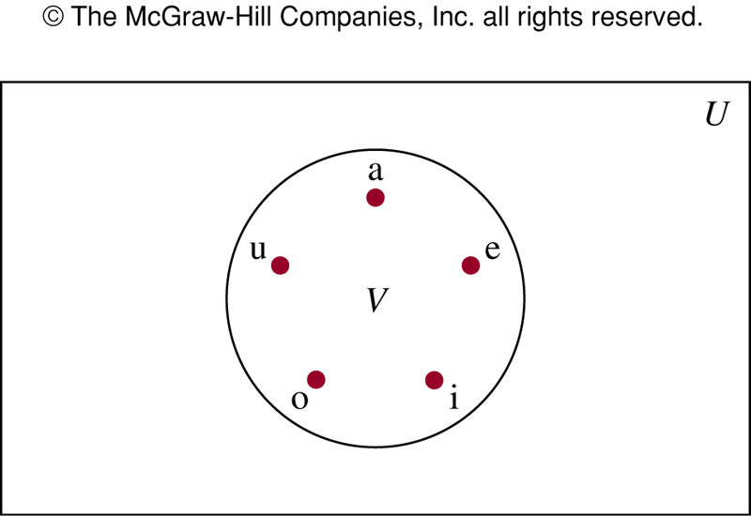
FIGURE 1 (2.1)
FIGURE 1 Venn Diagram for the Set of Vowels.
歐亞書局
P. 114
Notes:
p:\msoffice\My Projects\Rosen 6e 2007\Imagebank\JPEGs07-24-06\ch02\jpeg\02_1_001.jpg

Slide 7
Definition 4: The set A is a subset of B if and only if every element of A is also an element of B.
A ⊆ B iff ∀x(x ∈ A → x ∈ B)
Theorem 1: For every set S,
(1) ∅ ⊆ S and (2) S ⊆ S.
Proper subset: A ⊂ B
∀x(x ∈ A → x ∈ B) ∧ ∃x(x ∈ B ∧ x ∉ A)

Slide 8
If A⊆B and B⊆A, then A=B
Sets may have other sets as members
  A={∅, {a}, {b}, {a,b}}
  B={x|x is a subset of the set {a,b}}
  A=B

Slide 9
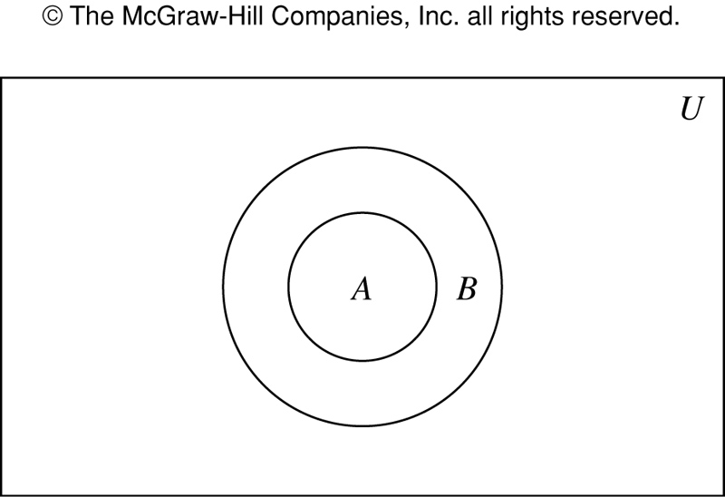
FIGURE 2 (2.1)
FIGURE 2 Venn Diagram Showing that A Is a Subset of B.
歐亞書局
P. 115
Notes:
p:\msoffice\My Projects\Rosen 6e 2007\Imagebank\JPEGs07-24-06\ch02\jpeg\02_1_002.jpg

Slide 10
Definition 5: If there are exactly n distinct members in the set S (n is a nonnegative integer), we say that S is a finite set and that n is the cardinality of S.
|S|= n
  |∅|=0
Definition 6: A set is infinite if it’s not finite.
  Z⁺

Slide 11
The Power Set
Definition 7: The power set of S is the set of all subset of the set S. P(S)
  P({0,1,2})
  P(∅)
  P({∅})
If a set has n elements, then its subset has 2^{n} elements.

Slide 12
Cartesian Products
Definition 8: Ordered n-tuple (a₁, a₂, …, a_{n}) is the ordered collection that has a_{i} as its ith element for i=1, 2, …, n.
Definition 9: Cartesian product of A and B, denoted by A × B, is the set of all ordered pairs (a, b), where a ∈ A and b ∈ B.
A × B = {(a, b)| a ∈ A ∧ b ∈ B}
  E.g. A = {1, 2}, B = {a, b, c}
  A × B and B × A are not equal, unless A=∅ or B=∅ or A=B

Slide 13
Definition 10: Cartesian product of A₁, A₂, …, A_{n}, denoted by A₁× A₂ × …× A_{n}, is the set of all ordered n-tuples (a₁, a₂, …, a_{n}), where a_{i} ∈ A_{i} for i=1,2,…,n.
A₁× A₂ × …× A_{n} = {(a₁, a₂, …, a_{n})| a_{i} ∈ A_{i} for i=1,2,…,n}

Slide 14
Using set notation with quantifiers
  ∀x∈S (P(x)): ∀x (x∈S → P(x))
  ∃x∈S (P(x)): ∃x (x∈S ∧ P(x))
Truth sets of quantifiers
  Truth set of P: {x ∈ D | P(x)}

Slide 15
2.2 Set Operations
Definition 1: The union of the sets A and B, denoted by A∪B, is the set containing those elements that are either in A or in B, or in both.
  A∪B={x|x∈A ∨ x∈B}
Definition 2: The intersection of the sets A and B, denoted by A∩B, is the set containing those elements in both A and B.
  A ∩ B={x|x∈A ∧ x∈B}

Slide 16
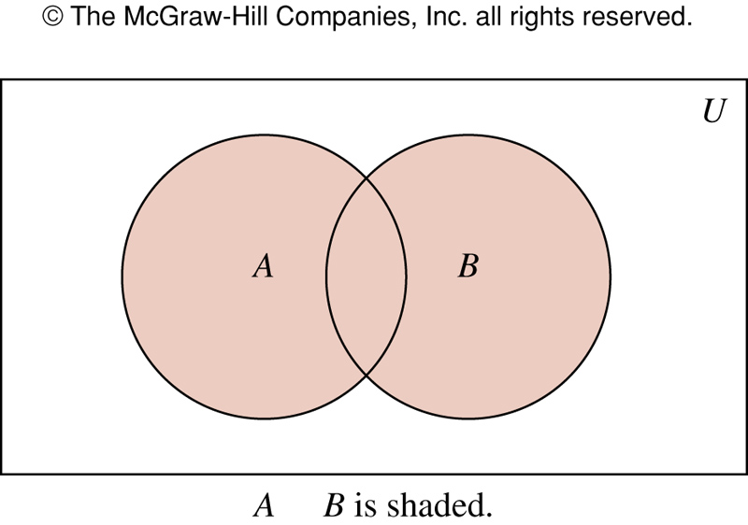
Figure 1 (2.2)
∪
FIGURE 1 Venn Diagram Representing the Union of A and B.
歐亞書局
P. 122
Notes:
p:\msoffice\My Projects\Rosen 6e 2007\Imagebank\JPEGs07-24-06\ch02\jpeg\02_2_001.jpg

Slide 17
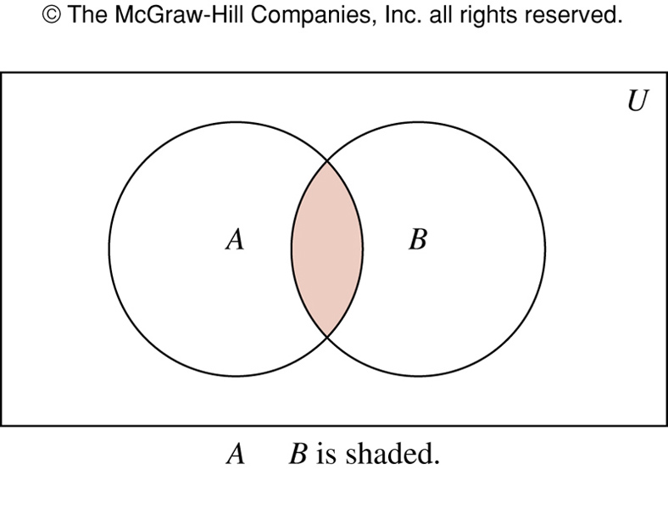
FIGURE 2 (2.2)
∩
FIGURE 2 Venn Diagram Representing the Intersection of A and B.
歐亞書局
P. 122
Notes:
p:\msoffice\My Projects\Rosen 6e 2007\Imagebank\JPEGs07-24-06\ch02\jpeg\02_2_002.jpg

Slide 18
Definition 3: Two sets are disjoint if their intersection is the empty set.
|A∪B|=|A|+|B|-| A ∩ B |
  Principle of inclusion-exclusion

Slide 19
Definition 4: The difference of the sets A and B, denoted by A-B, is the set containing those elements that are in A but not in B.
  Complement of B with respect to A
  A-B={x|x∈A ∧ x∉B}
Definition 5: The complement of the set A, denoted by Ā, is the complement of A with resepect to U.
  Ā = {x|x∉A}

Slide 20
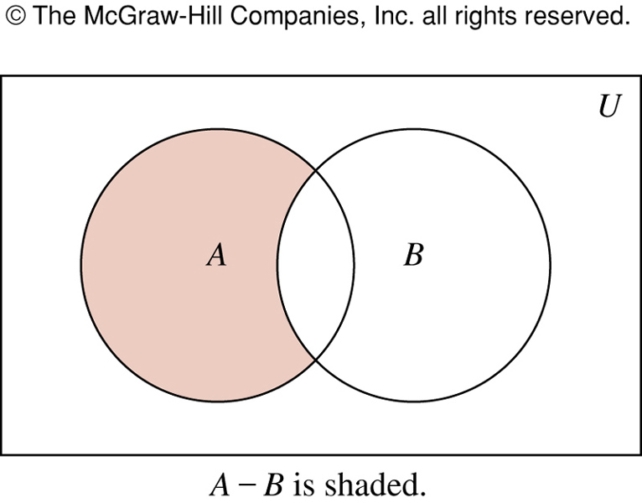
FIGURE 3 (2.2)
FIGURE 3 Venn Diagram for the Difference of A and B.
歐亞書局
P. 123
Notes:
p:\msoffice\My Projects\Rosen 6e 2007\Imagebank\JPEGs07-24-06\ch02\jpeg\02_2_003.jpg

Slide 21
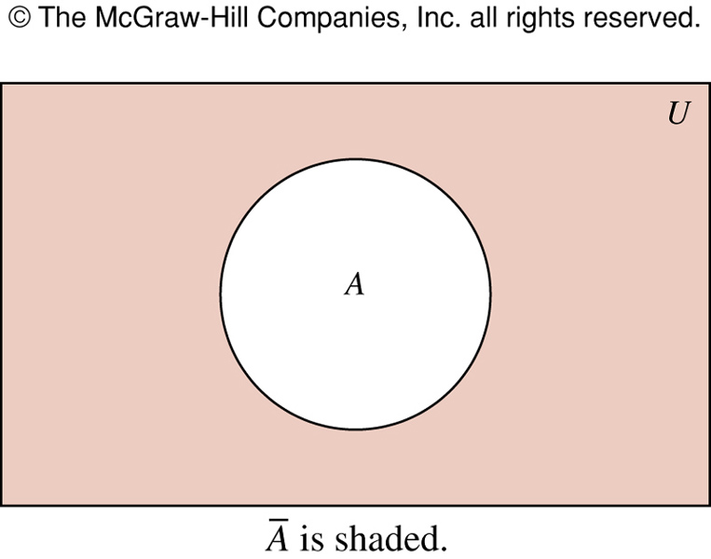
FIGURE 4 (2.2)
FIGURE 4 Venn Diagram for the Complement of the Set A.
歐亞書局
P. 123
Notes:
p:\msoffice\My Projects\Rosen 6e 2007\Imagebank\JPEGs07-24-06\ch02\jpeg\02_2_004.jpg

Slide 22
Set Identities
To prove set identities
  Show that each is a subset of the other
  Using membership tables
  Using those that we have already proved

Slide 23
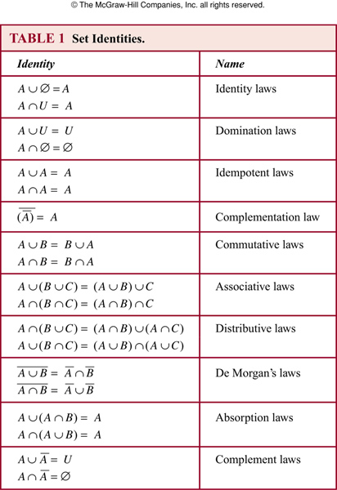
TABLE 1 (2.2)
歐亞書局
P. 124
Notes:
p:\msoffice\My Projects\Rosen 6e 2007\Imagebank\JPEGs07-24-06\ch02\jpeg\t02_2_01.jpg

Slide 24
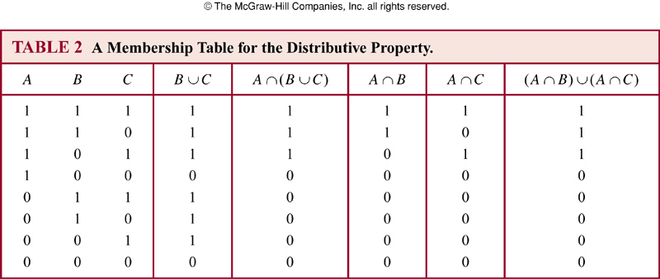
TABLE 2 (2.2)
歐亞書局
P. 126
Notes:
p:\msoffice\My Projects\Rosen 6e 2007\Imagebank\JPEGs07-24-06\ch02\jpeg\t02_2_02.jpg

Slide 25

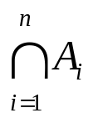
Generalized Unions and Intersections
Definition 6: The union of a collection of sets is the set containing those elements that are members of at least one set in the collection.
  A₁∪ A₂ ∪ … ∪ A_{n} =
Definition 7: The intersection of a collection of sets is the set containing those elements that are members of all the sets in the collection.
  A₁∩ A₂ ∩ … ∩ A_{n} =
Computer Representation of Sets
  Using bit strings

Slide 26
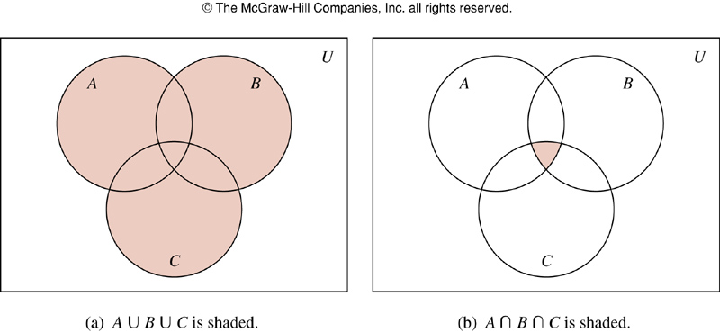
FIGURE 5 (2.2)
FIGURE 5 The Union and Intersection of A, B, and C.
歐亞書局
P. 127
Notes:
p:\msoffice\My Projects\Rosen 6e 2007\Imagebank\JPEGs07-24-06\ch02\jpeg\02-2-005.jpg

Slide 27
2.3 Functions
Definition 1: A function f from A to B is an assignment of exactly one element of B to each element of A. f: A→B
Definition 2: f: A→B.
  A: domain of f, B: codomain of f.
  f(a)=b, a: preimage of b, b: image of a.
  Range of f: the set of all images of elements of A
  f: maps A to B

Slide 28
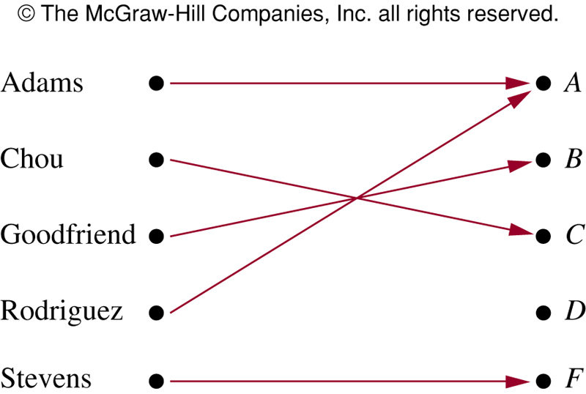
FIGURE 1 (2.3)
FIGURE 1 Assignment of Grades in a Discrete Mathematics Class.
歐亞書局
P. 133
Notes:
p:\msoffice\My Projects\Rosen 6e 2007\Imagebank\JPEGs07-24-06\ch02\jpeg\02-3-001.jpg

Slide 29
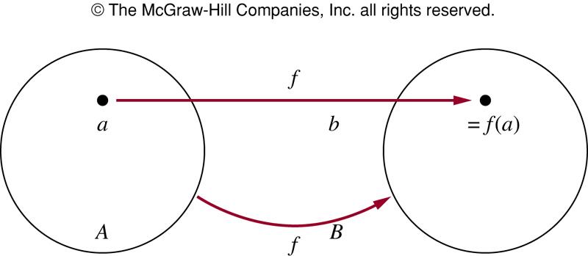
FIGURE 2 (2.3)
FIGURE 2 The Function f Maps A to B.
歐亞書局
P. 134
Notes:
p:\msoffice\My Projects\Rosen 6e 2007\Imagebank\JPEGs07-24-06\ch02\jpeg\02-3-002.jpg

Slide 30
Definition 3: Let f₁ and f₂ be functions from A to R. f₁+f₂ and f₁f₂ are also functions from A to R:
  (f₁+f₂)(x) = f₁(x)+f₂(x)
  (f₁f₂)(x)=f₁(x)f₂(x)
Definition 4: f: A→B, S is a subset of A. The image of S under the function f is: f(S)={t|∃s∈S(t=f(s))}

Slide 31
One-to-One and Onto Functions
Definition 5: A function f is one-to-one or injective, iff f(a)=f(b) implies that a=b for all a and b in the domain of f.
  ∀a∀b( f(a)=f(b) → a=b ) or
  ∀a∀b( a ≠ b → f(a) ≠ f(b) )
Definition 6: A function f is increasing if f(x)≤f(y), and strictly increasing if f(x)<f(y) whenever x<y. f is called decreasing if f(x)≥f(y), and strictly decreasing if f(x)>f(y) whenever x<y.

Slide 32
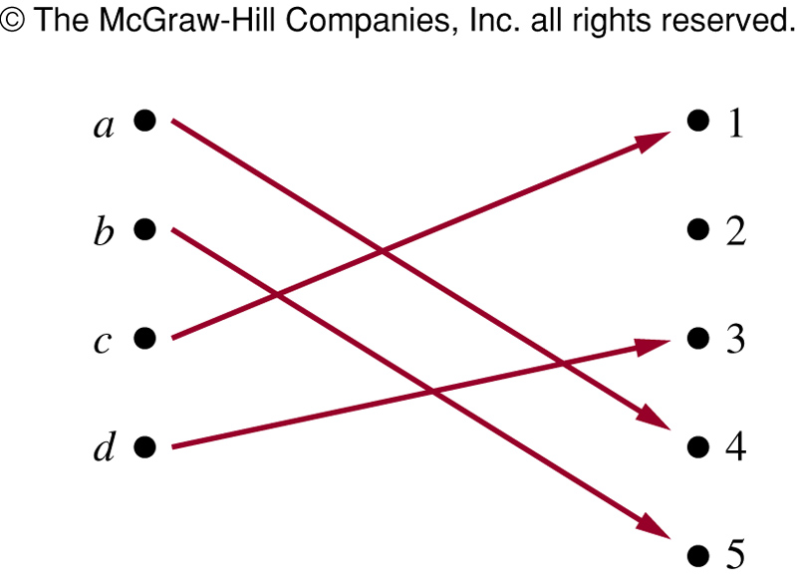
FIGURE 3 (2.3)
FIGURE 3 A One-to-One Function.
歐亞書局
P. 137
Notes:
p:\msoffice\My Projects\Rosen 6e 2007\Imagebank\JPEGs07-24-06\ch02\jpeg\02-3-003.jpg

Slide 33
One-to-One and Onto Functions
Definition 7: A function f is onto or surjective, iff for every element b∈B there is an element a∈A with f(a)=b.
  ∀y∃x( f(x)=y ) or
  ∀a∀b( a ≠ b → f(a) ≠ f(b) )
Definition 8 A function f is a one-to-one correspondence or a bijection if it is both one-to-one and onto.
  Ex: identity function ι_{A}(x)=x

Slide 34
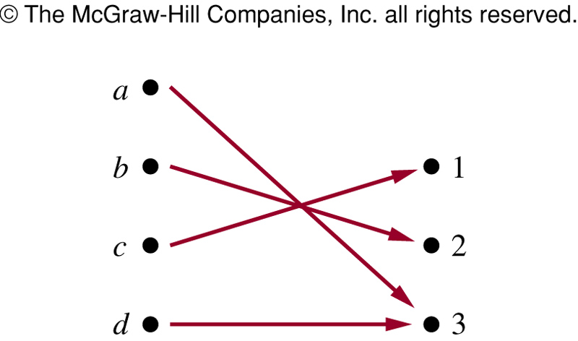
FIGURE 4 (2.3)
FIGURE 4 An Onto Function.
歐亞書局
P. 138
Notes:
p:\msoffice\My Projects\Rosen 6e 2007\Imagebank\JPEGs07-24-06\ch02\jpeg\02-3-004.jpg

Slide 35
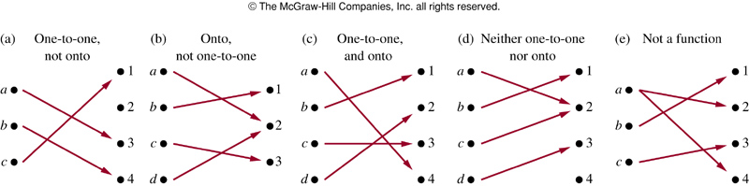
FIGURE 5 (2.3)
FIGURE 5 Examples of Different Types of Correspondences.
歐亞書局
P. 139
Notes:
p:\msoffice\My Projects\Rosen 6e 2007\Imagebank\JPEGs07-24-06\ch02\jpeg\02-3-005.jpg

Slide 36
Inverse Functions and Compositions of Functions
Definition 9: Let f be a one-to-one correspondence from A to B. The inverse function of f is the function that assigns to an element b in B the unique element a in A such that f(a)=b.
  f⁻¹(b)=a when f(a)=b

Slide 37
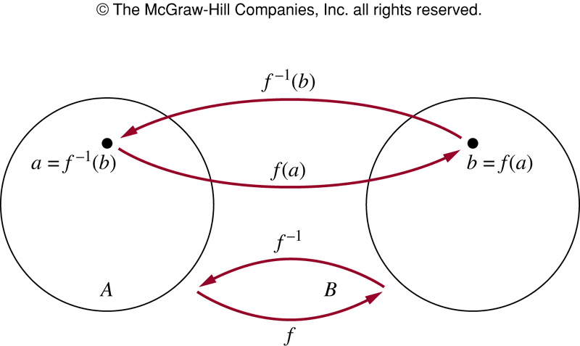
FIGURE 6 (2.3)
FIGURE 6 The Function f ^{－1} Is the Inverse of Function f.
歐亞書局
P. 139
Notes:
p:\msoffice\My Projects\Rosen 6e 2007\Imagebank\JPEGs07-24-06\ch02\jpeg\02-3-006.jpg

Slide 38
Definition 10: Let g be a function from A to B, and f be a function from B to C. The composition of functions f and g, denoted by f○g, is defined by:
  f○g(a) = f(g(a))
  f○g and g○f are not equal

Slide 39
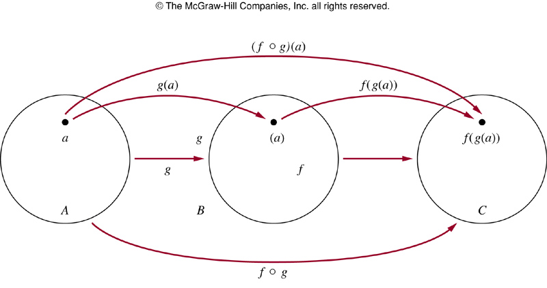
FIGURE 7 (2.3)
FIGURE 7 The Composition of the Functions f and g.
歐亞書局
P. 141
Notes:
p:\msoffice\My Projects\Rosen 6e 2007\Imagebank\JPEGs07-24-06\ch02\jpeg\02-3-007.jpg

Slide 40
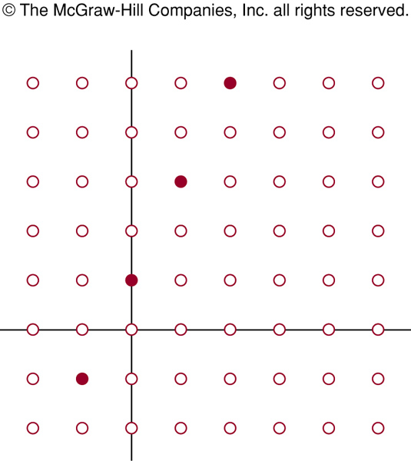
FIGURE 8 (2.3)
FIGURE 8 The Graph of f(n) = 2n + 1 from Z to Z.
歐亞書局
P. 142
Notes:
p:\msoffice\My Projects\Rosen 6e 2007\Imagebank\JPEGs07-24-06\ch02\jpeg\02-3-008.jpg

Slide 41
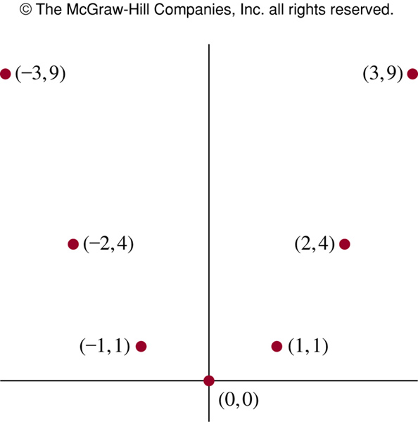
FIGURE 9 (2.3)
FIGURE 9 The Graph of f(x) = x² from Z to Z.
歐亞書局
P. 142
Notes:
p:\msoffice\My Projects\Rosen 6e 2007\Imagebank\JPEGs07-24-06\ch02\jpeg\02-3-009.jpg

Slide 42
Graphs of Functions
Definition 11: The graph of function f is the set of ordered pairs {(a,b)|a∈A and f(a)=b}
Definition 12: The floor function assigns to x the largest integer that is less than or equal to x (⎣x⎦ or [x]). The ceiling function assigns to x the smallest integer that is greater than or equal to x (⎡x⎤).

Slide 43
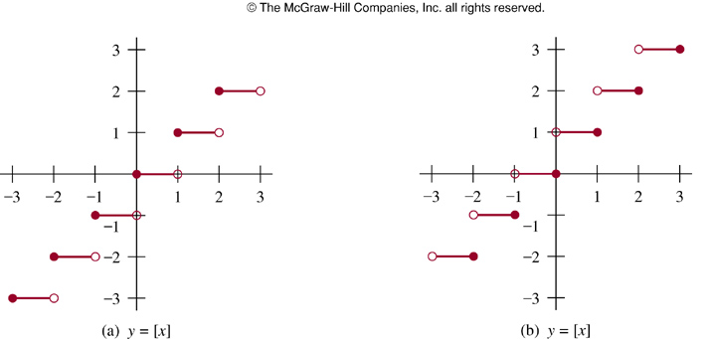
FIGURE 10 (2.3)
FIGURE 10 Graphs of the (a) Floor and (b) Ceiling Functions.
歐亞書局
P. 143
Notes:
p:\msoffice\My Projects\Rosen 6e 2007\Imagebank\JPEGs07-24-06\ch02\jpeg\02-3-010.jpg

Slide 44
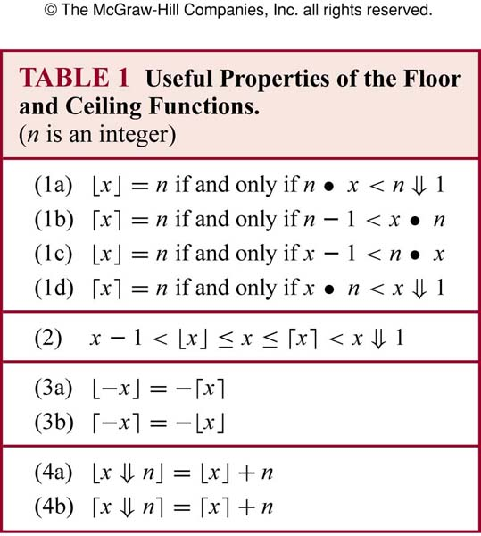
TABLE 1 (2.3)
歐亞書局
P. 144
Notes:
p:\msoffice\My Projects\Rosen 6e 2007\Imagebank\JPEGs07-24-06\ch02\jpeg\t02-3-01.jpg

Slide 45
2.4 Sequences and Summations
Definition 1: A sequence is a function from a subset of the set of integers to a set S. We use a_{n} to denote the image of the integer n (a term of the sequence)
  The sequence {a_{n}}
    Ex: a_{n}=1/n

Slide 46
Definition 2: A geometric progression is a sequence of the form
a, ar, ar², …, ar^{n}, …
where the initial term a and the common ratio r are real numbers
Definition 3: A arithmetic progression is a sequence of the form
a, a+d, a+2d, …, a+nd, …
where the initial term a and the common difference d are real numbers

Slide 47
Ex. 1, 3, 5, 7, 9, …
Ex. 1, 2, 2, 3, 3, 3, 4, 4, 4, 4, …
Ex. 1, 7, 25, 79, 241, 727, 2185, 6559, 19681, 59047, …

Slide 48
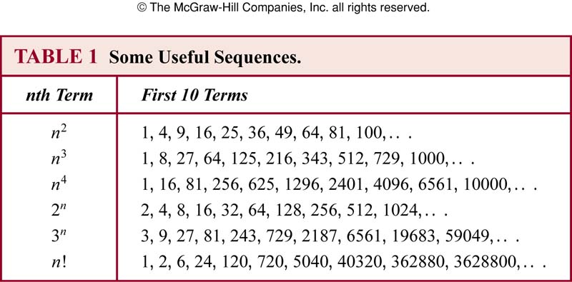
TABLE 1 (2.4)
歐亞書局
P. 153
Notes:
p:\msoffice\My Projects\Rosen 6e 2007\Imagebank\JPEGs07-24-06\ch02\jpeg\t02-4-01.jpg

Slide 49
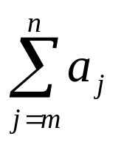
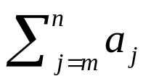
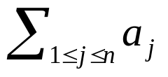
Summations
Summation notation:
  a_{m}+a_{m+1}+…+a_{n}
  j: index of summation
  m: lower limit
  n: upper limit

Slide 50
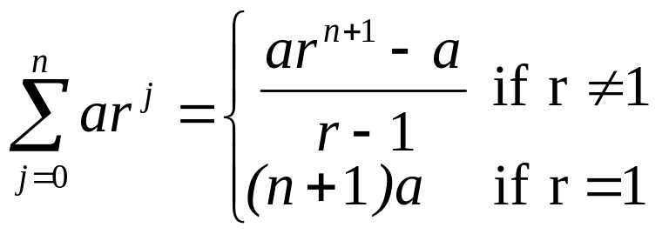
Theorem 1 (geometric series): If a and r are real numbers and r≠0, then
  Proof

Slide 51
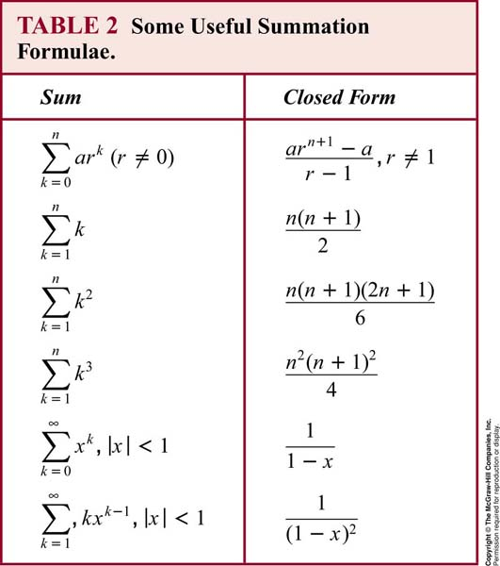
TABLE 2 (2.4)
歐亞書局
P. 157
Notes:
p:\msoffice\My Projects\Rosen 6e 2007\Imagebank\JPEGs07-24-06\ch02\jpeg\t02-4-02.jpg

Slide 52
Cardinality
Definition 4: The sets A and B have the same cardinality iff there is a one-to-one correspondence from A to B.
Definition 5: A set that is either finite or has the same cardinality as the set of positive integers is called countable. A set that is not countable is called uncountable. When an infinite set S is countable, |S|=א₀ (“aleph null”)
  Ex: the set of odd positive integers is countable

Slide 53
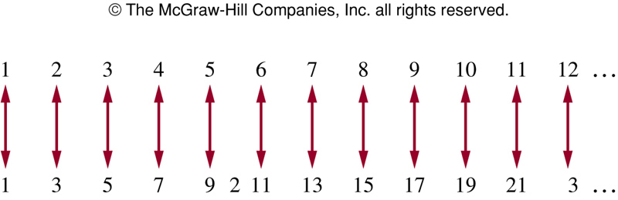
FIGURE 1 (2.4)
FIGURE 1 A One-to-One Correspondence Between Z⁺ and the Set of Odd Positive Integers.
歐亞書局
P. 159
Notes:
p:\msoffice\My Projects\Rosen 6e 2007\Imagebank\JPEGs07-24-06\ch02\jpeg\02-4-001.jpg

Slide 54
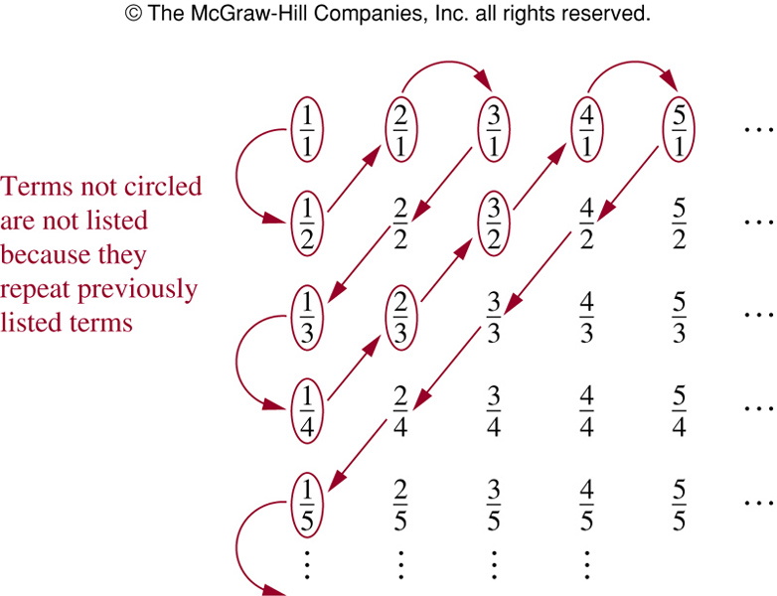
FIGURE 2 (2.4)
FIGURE 2 The Positive Rational Numbers Are Countable.
歐亞書局
P. 159
Notes:
p:\msoffice\My Projects\Rosen 6e 2007\Imagebank\JPEGs07-24-06\ch02\jpeg\02-4-002.jpg

Slide 55
Thanks for Your Attention!

